Slide 1
Getting Started with Crowdin for Qiskit Documentation Translation
Yuri Kobayashi

Slide 2
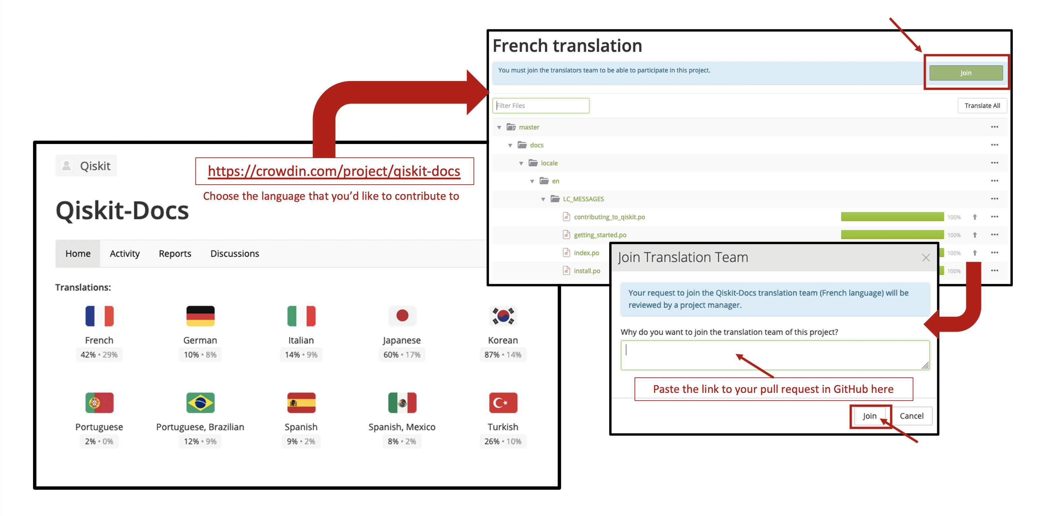
Prerequisite
You must complete the following steps given that your new language request has met the criteria here.
Open the LOCALIZATION_CONTRIBUTORS file. Look for the language header that you'd like to contribute to and sign up under there. If you do not find the language that you'd like to contribute to, please read this section.
Create a pull request (PR) to add your name to the list. Make sure to follow the template to open a Pull Request. (Each contributor has to create their own PR and sign the CLA)
In the Qiskit-Docs Crowdin project, choose the language that you want to contribute to.
Click the Join button and paste the URL of your PR in the dialog box where you are asked why you want to join the Crowdin project.
The administrators of Crowdin project will review your request and grant you access.
For details visit: https://github.com/qiskit-community/qiskit-translations/blob/master/README.md

Slide 3
Step 1: Sign in to Crowdin!
https://crowdin.com/project/qiskit-docs

Slide 4
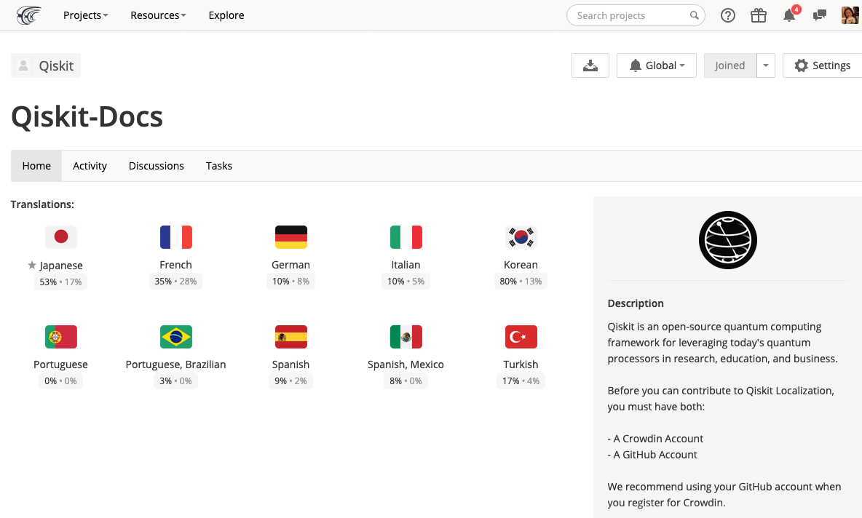
Step 2: Choose the Language

Slide 5
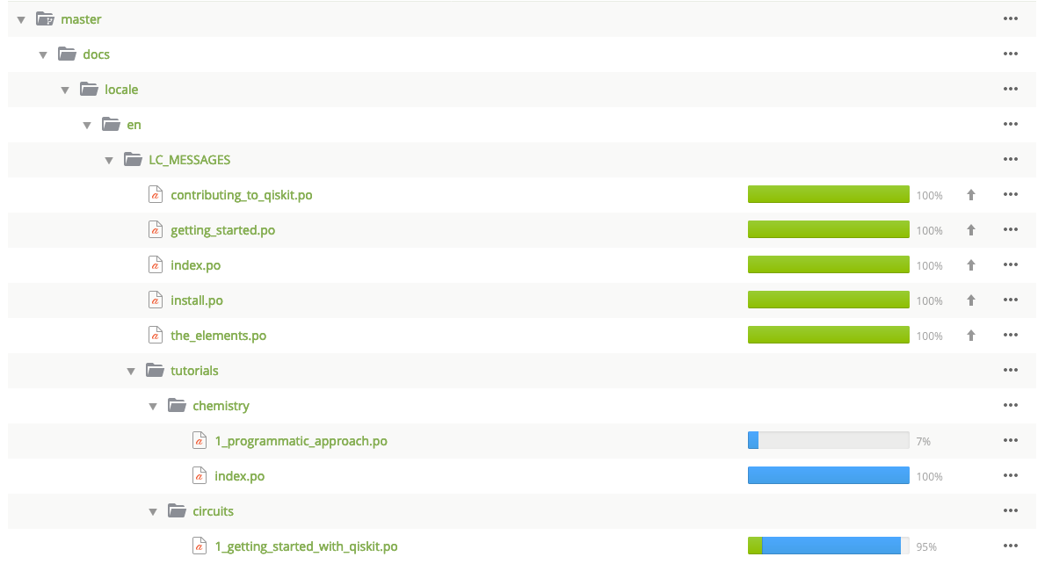
Step 3: Choose a file to translate
High priority files are shown with an arrow
Start with these files

Slide 6
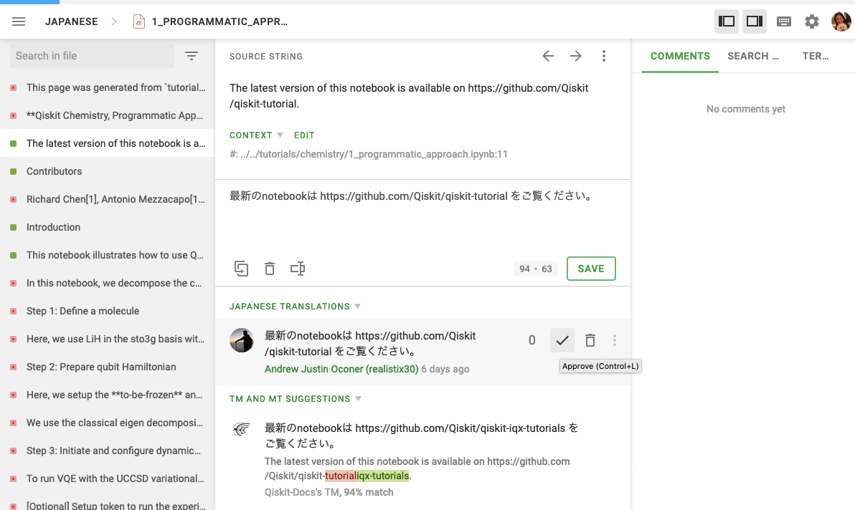
Step 4: Start translating
Green (■ mark) indicates that these strings have been translated already
1 Check source file for context
Source Files can be found at: All files except tutorials
https://github.com/Qiskit/qiskit/tree/master/docs :
Tutorials
https://github.com/Qiskit/qiskit-tutorials/tree/master/tutorials
Orange (■ mark) indicates that these strings have not been translated yet
2. Refer to TM an MT Suggestions and apply if relevant.

Slide 7
Step 5: Proof-read and approve
Proof-read and suggest or make changes if necessary.
Approve finalized translation by clicking on the check ☑️ mark.

Slide 8
Translation Tips
For translating Qiskit Documentations in Crowdin

Slide 9
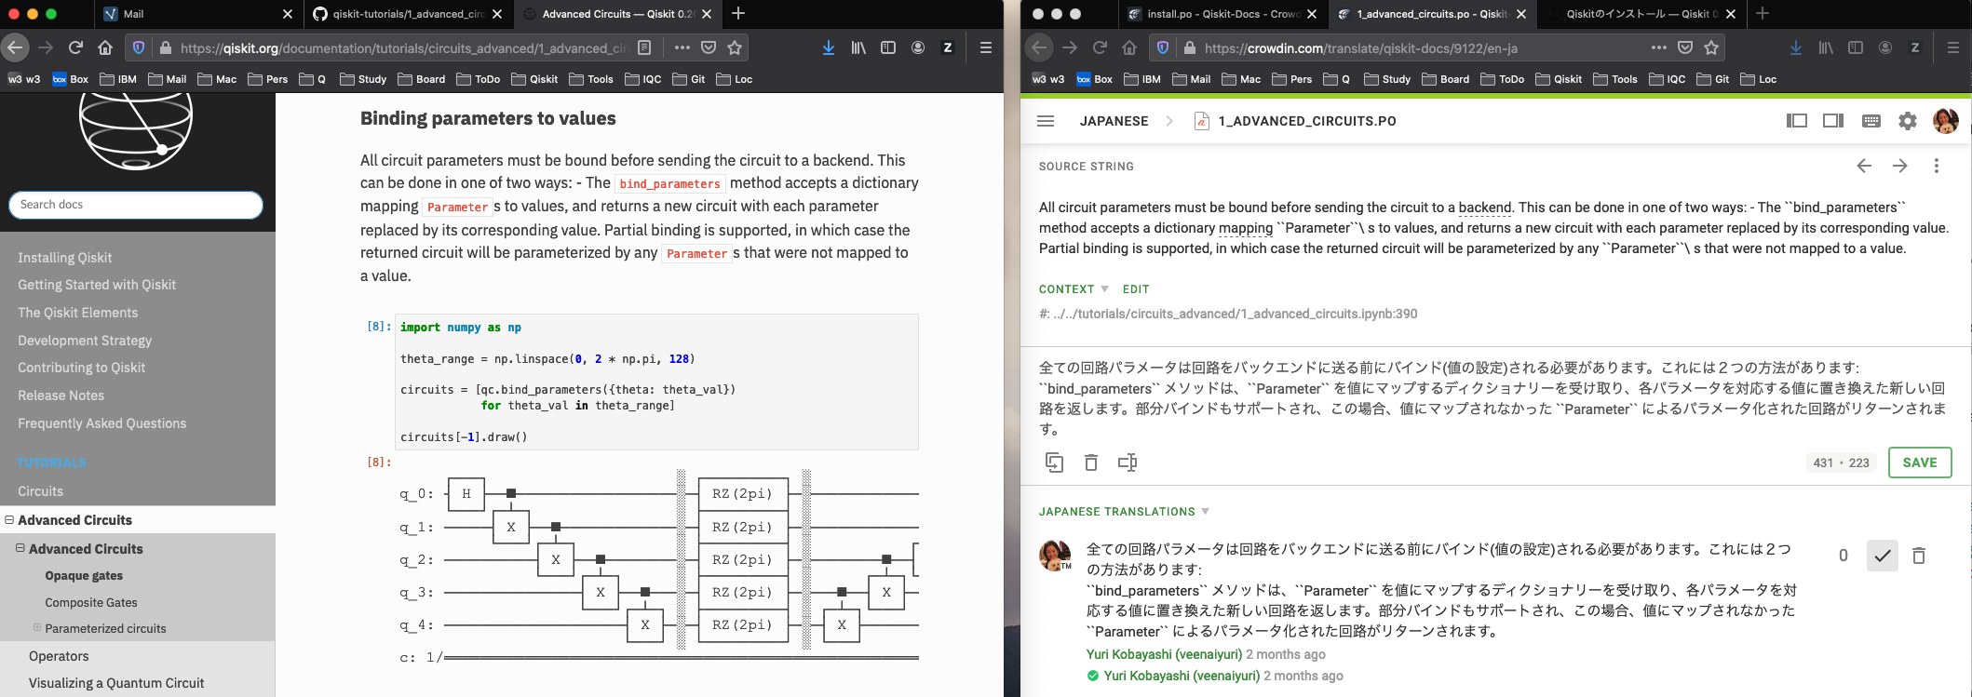
Translate in context
Making sure you see your source string in context is very important to do any quality translation work. While Crowdin allows user to translate string by string, it currently does not provide a wholistic view of the source page.
Tip1: Have the original page opened side by side with Crowdin editor while translating.
Original Page from Qiskit Docs
Crowdin Editor
Pull up the original docs
page and have it side by side with your Crowdin editor before you start translating
You can access and view Qiskit Documentation page here: https://qiskit.org/documentation/
All source files (except /tutorials) in Github https://github.com/Qiskit/qiskit/tree/master/docs
/tutorials source files in Github https://github.com/Qiskit/qiskit-tutorials/tree/master/tutorials
Bookmark these locations!

Slide 10
How to treat hyper links
Hyperlinks: `Link text <http://example.com/>`__ are used to create inline weblinks. In most cases, the Link text refers to a proper noun such as an existing command, source, organization, service, product, etc. that should not be translated.
Tip 2: You should not translate the text that reference external websites
SOURCE STRING To enforce a consistent code style in the project, we use `Pylint <https://www.pylint.org>`__ and `pycodesytle <https://pycodestyle.readthedocs.io/en/latest/>`__ to verify that code contributions conform to
TRANSLATION プロジェクト内のコーディング・スタイルの統一を図るため、`Pylint <https://www.pylint.org>`__ と `pycodesytle <https://pycodestyle.readthedocs.io/en/latest/>`__ を使用して、コードへの貢献がプロジェクトのスタイルガイドに準拠していることを確認しています。
Tip 3: You may translate the text when it is an anchor link or reference link that points to a particular place in the same document.
SOURCE `Introduction <#introduction>`__ TRANSLATION ` はじめに <#introduction>`__ SOURCE STRING :ref:`Build Qiskit packages from source <install_install_from_source_label>`
TRANSLATION :ref:`ソースから Qiskitパッケージをビルドする <install_install_from_source_label>`

Slide 11
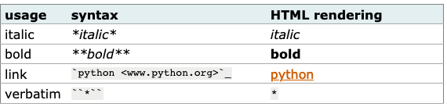
How to treat inline markups
There are a few special characters used to format text as shown below.
There are some restrictions about the * and `` syntax.
They cannot not be nested,
The content may not start or end with whitespace: * text* is wrong,
it must be separated from surrounding text by non-word characters like a space.

Slide 12

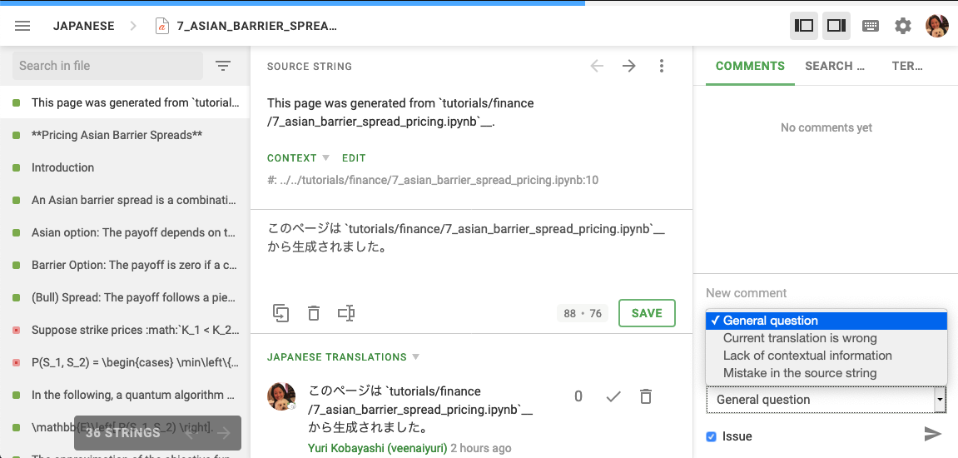
Miscellaneous Tips
You can filter strings by clicking the mark next to the search in file on the upper left.
You can send comment to your team members or the Crowdin admin members using the Crowdin messaging.
Filter
Add comments to communicate
with your team members and translation leads.

Slide 13
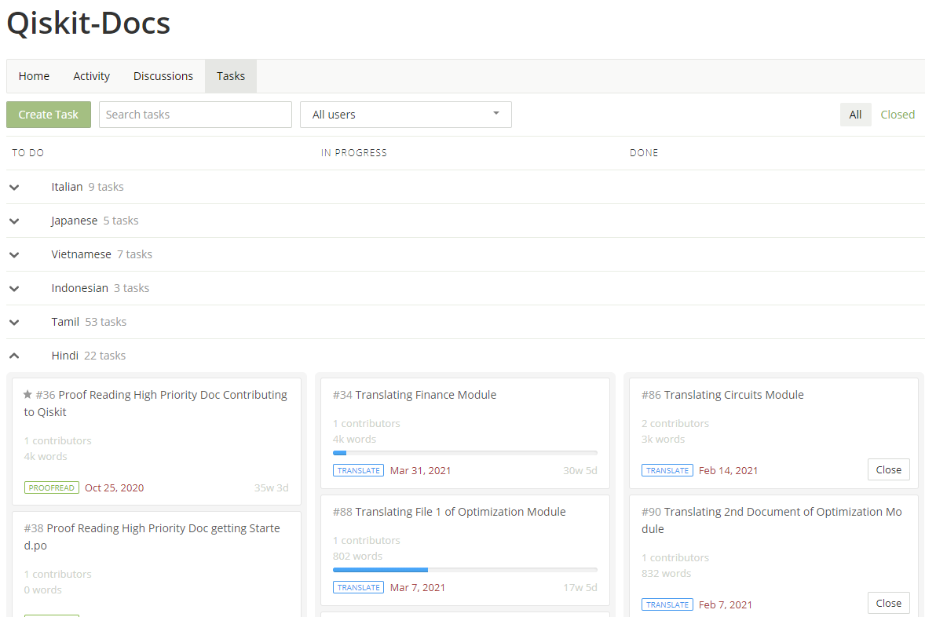
Assigning Tasks
You can choose to assign tasks to team members on Crowdin to help with your workflow.
You can do this by going to “Tasks” on the menu bar of the project home page, clicking on the “Create Task” button in green on the top left, filling up the relevant fields and issuing the task to the selected member(s).
This is the Tasks Dashboard. You can manage the progress of tasks that you assign and update their status as needed between the options “To-Do”, “In Progress” and “Done” as listed above.

Slide 14
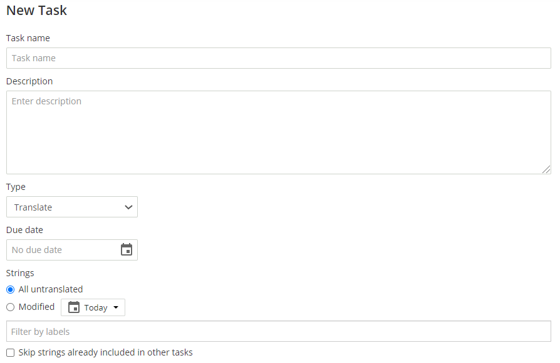
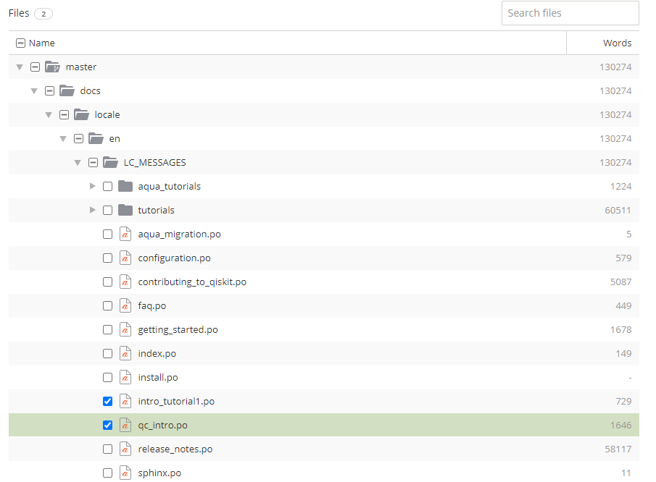
Assigning Tasks
You can choose to assign tasks to team members on Crowdin to help with your workflow.
You can do this by going to “Tasks” on the menu bar of the project home page, clicking on the “Create Task” button in green on the top left, filling up the relevant fields and issuing the task to the selected member(s).
Fill up details as needed
Select file(s) to be modified by current task

Slide 15
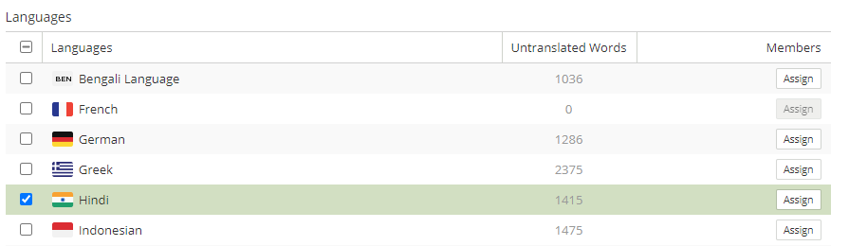
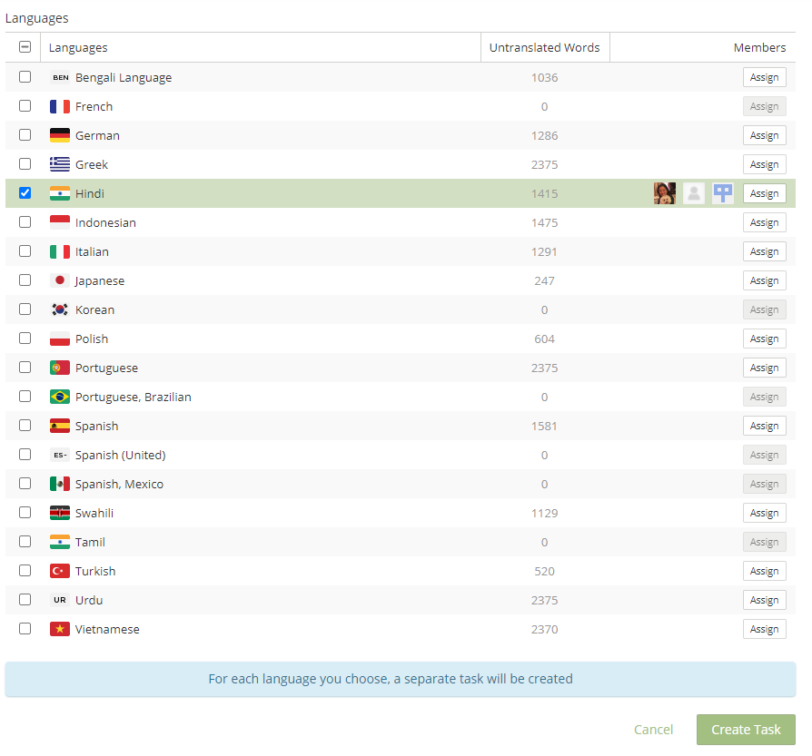
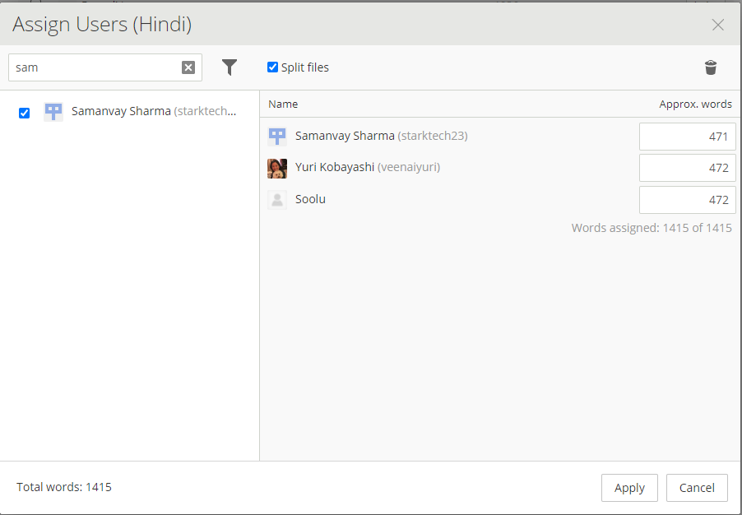
Assigning Tasks
Select your language and click on “Assign”
Assign team members, define parameters as needed, and click on “Apply”
Click on “Create Task” to assign task and notify selected members

Slide 16
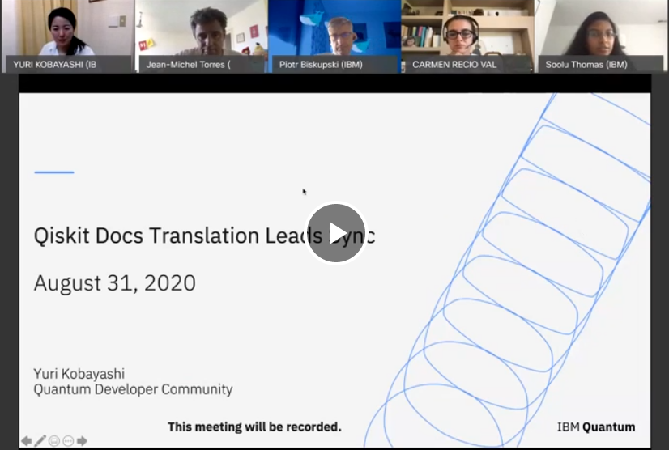
Translation Leads Bi-weekly Sync
Every other Tuesday 8am EST.
A time to share progress, translation priorities, useful tips, best practices
Recordings will be available to people who can provide their email addresses that are associated with their professional workplace or academic institutions.

Slide 17
Assigning Roles
For translating Qiskit Documentations in Crowdin

Slide 18
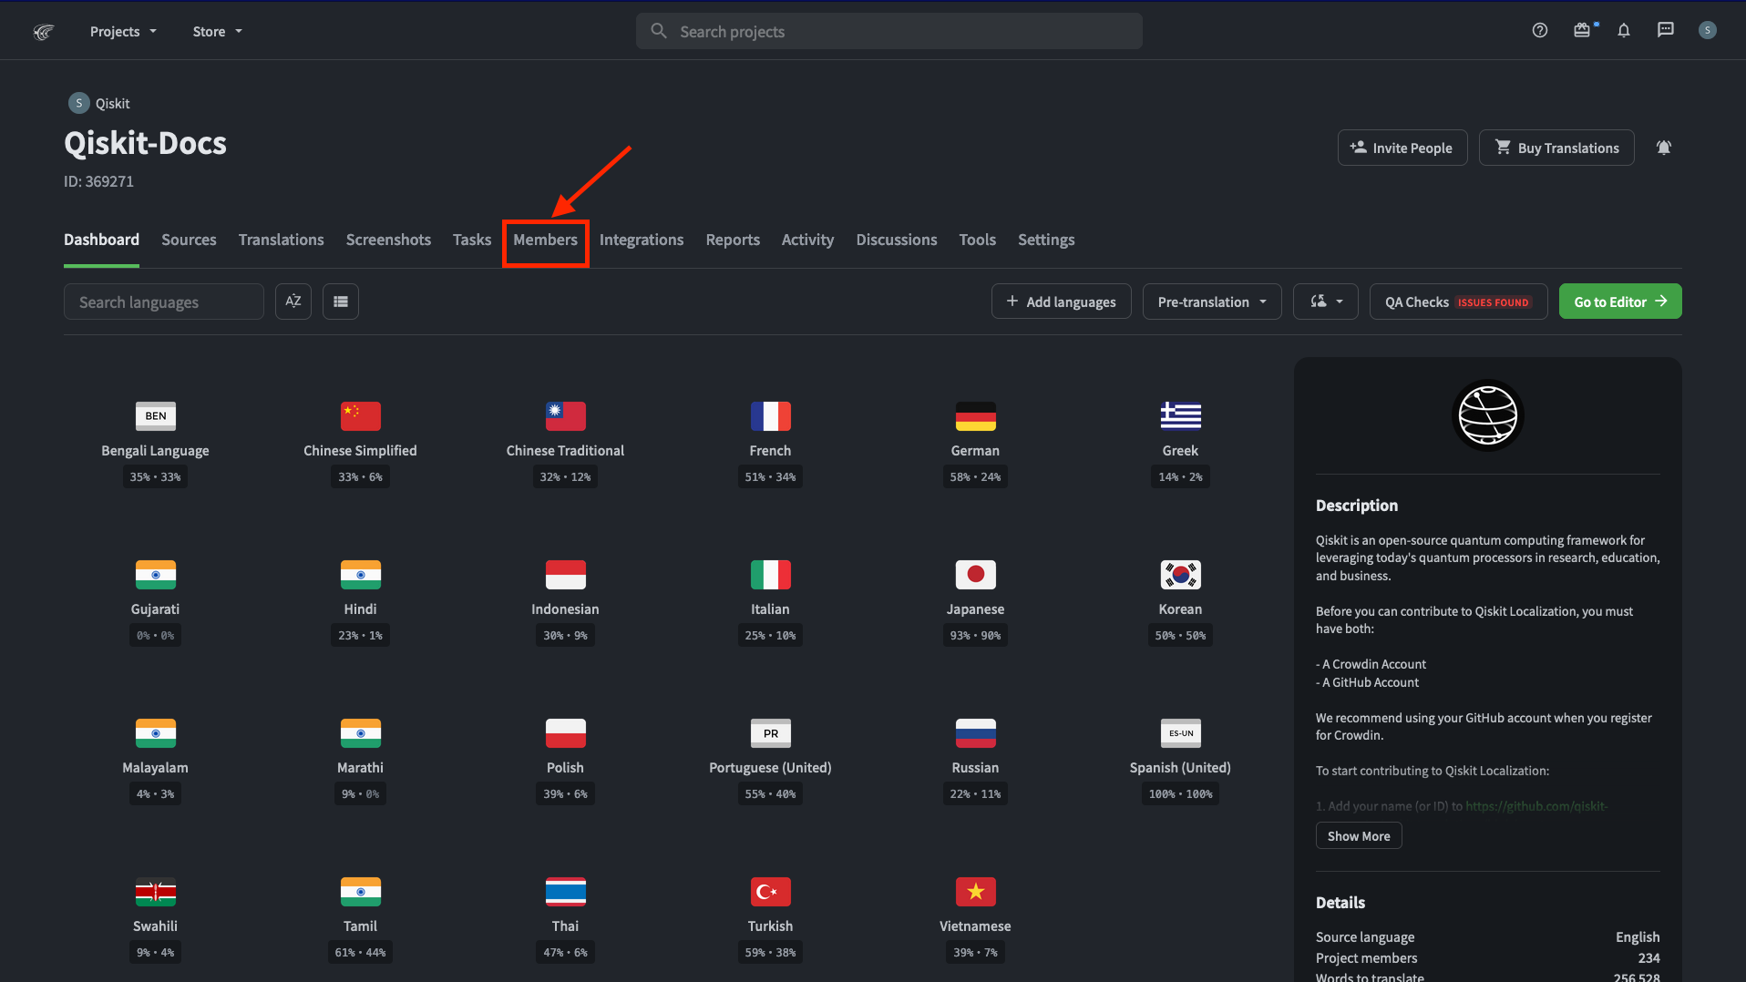
Assigning roles: Go to Members in Qiskit-Docs

Slide 19
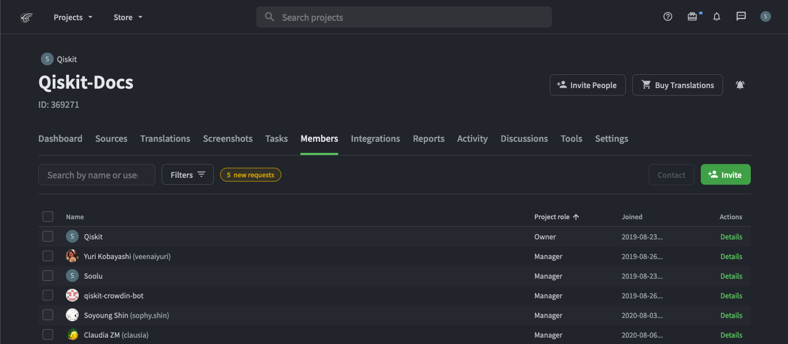
Assigning roles: Search for members you added

Slide 20
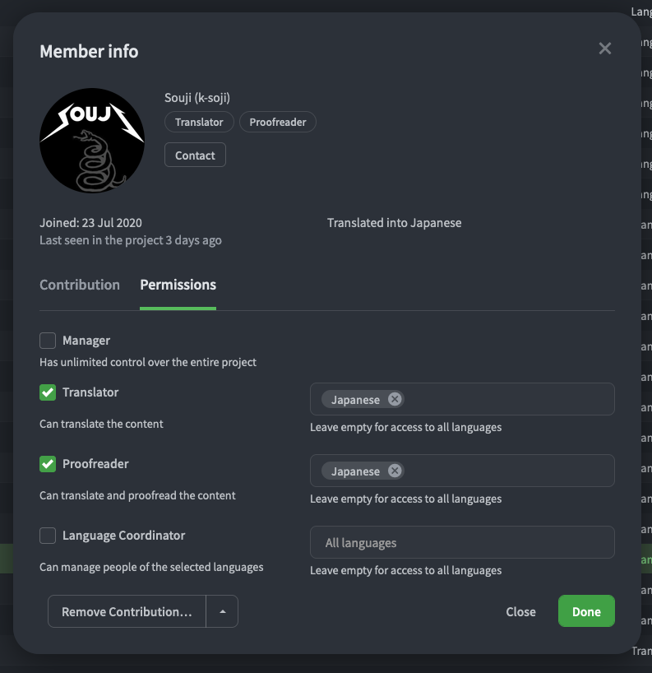
Assigning roles: Choose Translator > Permissions

Slide 21
Miscellaneous Tips
Some additional things for Translation Leads to keep in mind

Slide 22
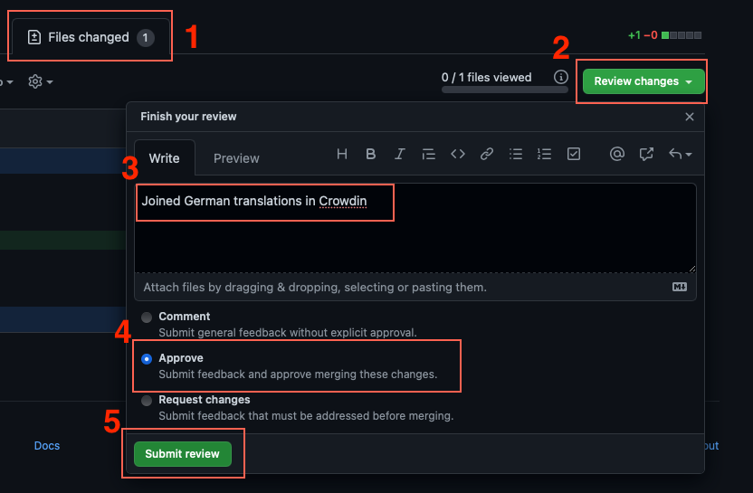
Accepting requests in Crowdin and GitHub
As the team is growing, we’d like the TLs to take up the responsibility of verifying and accepting incoming joining requests.
GitHub board to make this easier:
https://github.com/qiskit-community/qiskit-translations/projects/2
Things to make sure before accepting a request:
Pull request opened in Qiskit-translations repo
Signed CLA (green box in the PR)
Sent a joining request in Crowdin
Requested to join in Crowdin
Once these 3 are satisfied, leave a comment/approve/move the issue to “Final review” box in GitHub so that Soolu/Yuri/Sam can merge it and accept the request in Crowdin.

Slide 23
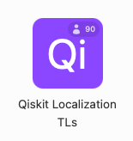
Progress Tracking Table (Airtable)
Created a spreadsheet in Airtable to track the progress of each teams
TLs should update it at most before the bi-weekly TL sync.
ibm.biz/progress-tracking-table
Reach out to Yuri or Sam if you can’t access the airtable.

Slide 24
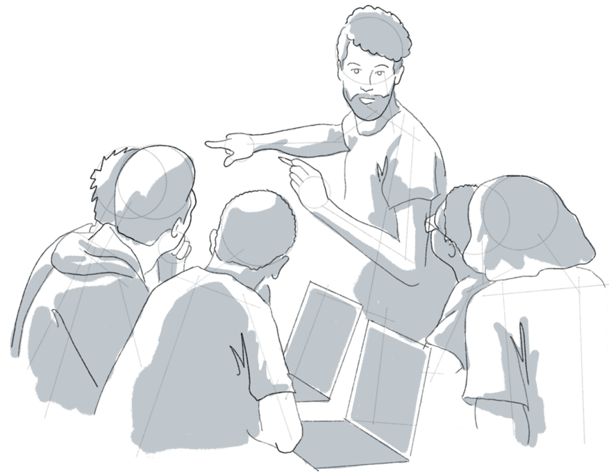
IBM Quantum Community Code of Conduct
In our collective mission to continue to promote and encourage an inclusive and welcoming global quantum community, The IBM Quantum Community Code of Conduct is available for download and review here. We appreciate everyone's support in this mission and ask that any observed code of conduct violations or inappropriate behavior be reported here.
[ Read Code of Conduct ]

Slide 25
Translate Responsibly
In addition to the IBM Quantum Community Code of Conduct, the Qiskit Localization Project values the following standards which are applicable in the context of community translation efforts.
Examples of translating responsibly:
Being mindful of the context when translating (having the original source material available to be referenced frequently is highly recommended).
Focusing on the quality of translations above quantity
Engaging in collaboration and valuing opinions and suggestions from other translators
Using tools such as the Sphinx editor and Staging site to check and correct syntax errors before accepting translations
Examples of irresponsible acts or translating may include:
Copy pasting other’s translation work
Blindly accepting translations without careful quality check
Abuse of machine translation with no regard to its translation quality
Other conduct which could be reasonably be considered inappropriate

Slide 26

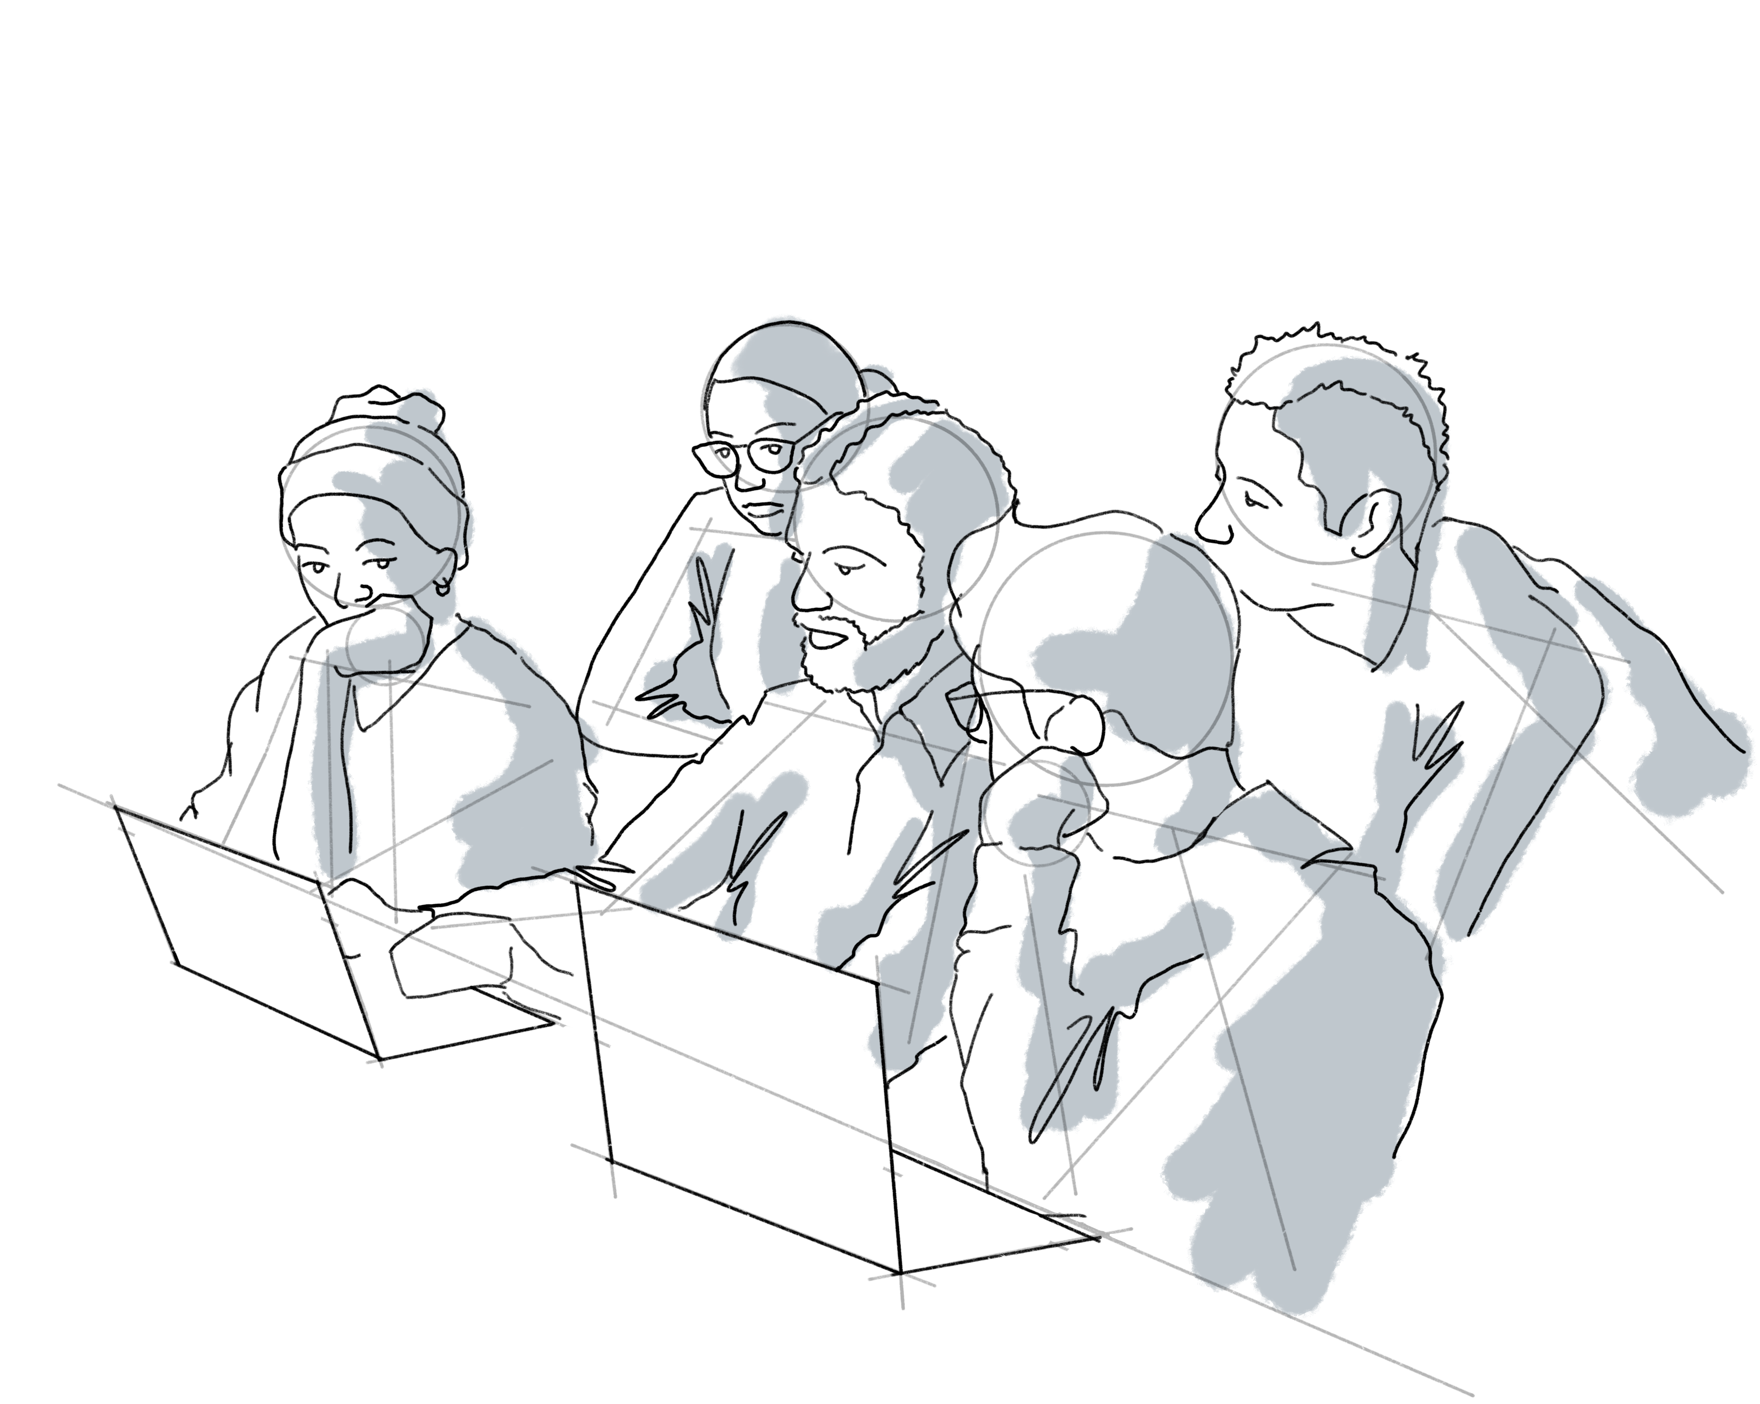
Contribute and earn your badge
Applications Open! Apply Here↓
https://ibm.biz/qiskit-docs
You can earn a badge through your localization contributions to the Qiskit and quantum community.
Contribution Period: April 15, 2023 – March 31, 2024
Qiskit-Docs Localziation Contributor Platinum Level Badge Image
Bronze Level – 5,000 words translated and/or approved Silver Level - 8,000 words translated and/or approved Gold Level – 15,000 words translated and/or approved Platinum Level – 25,000 words translated and/or approved

Slide 27
Some priorities
Focus on completing high priority/essential files.
Proofread ☺
Review your documentation using the staging site (https://ibm.biz/qiskit-docs-staging)

Slide 28
How to list your volunteer experience
You may list your volunteer experience in CVs and Linkedin, etc. Please list your experience the following way:
Team Lead for Turkish Translation
Qiskit Documentation Localization Project
Contributor for Turkish Translation
Qiskit Documentation Localization Project

Slide 29
Questions?
Please join #qiskit-localization channel in the Qiskit workspace or open an issue in the Qiskit. You can also join the Qiskit Docs Slack Workspace (http://bit.ly/qiskitdoc) once you join a localization team.

